Slide 1

Company Bankruptcy Prediction
Machine Learning Project
Group:
Denis Mugisha
Liu Guangqiang
Rachel Fanti

Slide 2
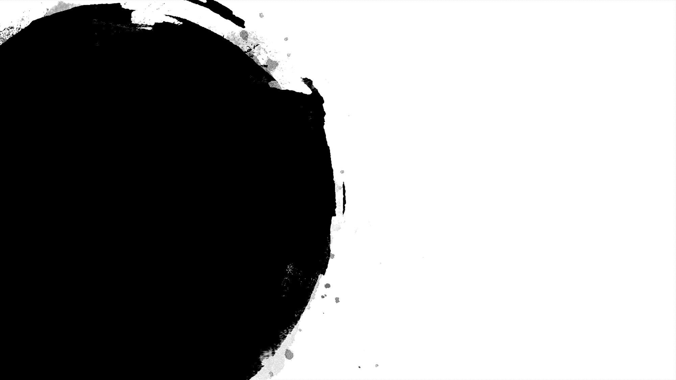

The dataset
Company Bankruptcy Prediction
Taiwan Economic Journal (1999–2009)
Company bankruptcy was defined based on business regulations of the Taiwan Stock Exchange
https://www.kaggle.com/fedesoriano/company-bankruptcy-prediction

Slide 3
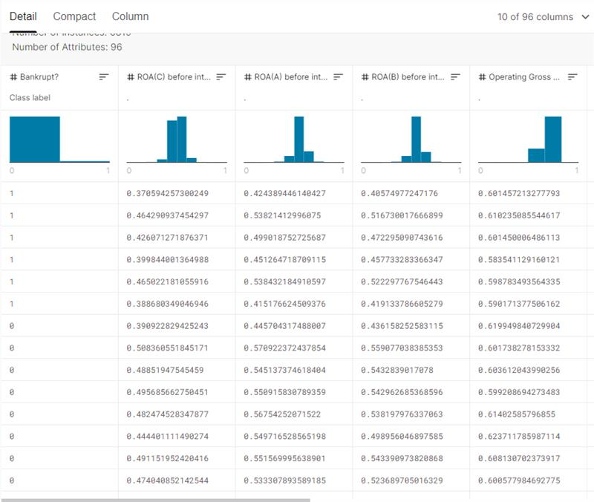
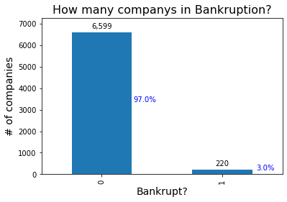
CHARACTERISTICS OF THE DATASET
96 features
y = Bankrupt (binary)
X = Financial and accounting indicators
93 float
2 binary
Unbalanced data

Slide 4
Examples of features
ROA (return on total assets) before interest and depreciation before interest
Operating gross margin: gross profit/net sales
Net Value Growth Rate: Total Equity Growth
Net profit before tax/Paid-in capital: Pre-tax Income/Capital
Interest Expense Ratio: Interest Expenses/Total Revenue
Net worth/Assets: Equity/Total Assets
Borrowing dependency: Cost of Interest-bearing Deb
Liability-Assets Flag: (1) if total liability exceeds total Assets / (0) otherwise
Net Income Flag: (1) if net income is negative for the last two years/ (0) otherwise
Notes:
Financial and accounting indicators:
1a. Net value growth rate refers to the growth rate of the net asset value of the fund in a certain period (such as one year)
Taxa de crescimento do valor líquido: crescimento total do patrimônio
1b. Net profit before tax/Paid-in capital: Pre-tax Income/Capital
Lucro líquido antes de impostos / capital integralizado: renda antes de impostos / capital
2a. Interest Expense Ratio: Interest Expenses/Total Revenue
Taxa de despesas de juros: despesas de juros / receita total
2b. Net worth/Assets: Equity/Total Assets
Patrimônio líquido / ativos: patrimônio líquido / ativos totais
3. Borrowing dependency: Cost of Interest-bearing Debt
Dependência de empréstimos: Custo da Dívida com Juros

Slide 5


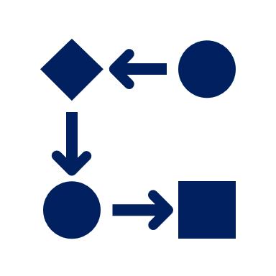

Summary
Problem description
Feature selection
Algorithm Implementation
Results

Slide 6



Summary
Problem description
Feature selection
Algorithm Implementation
Results

Slide 7
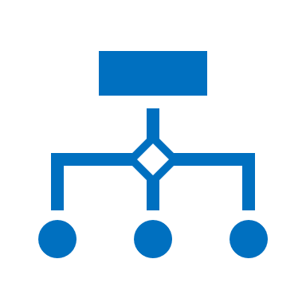



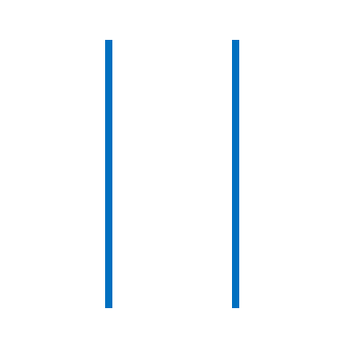

Problem description and tasks
Decision Trees
Select the criteria that should take into account to suggest if a company is bankrupt or not.
Which features impact the bankruptcy classification the most and how much?
Compare probability of bankrupt with probability of not bankrupt, according to the selected features.
These classes can be separated for a hyper plane?
These classes can be separated by clusters?
Evaluating different algorithms (format 2)
Neural Network
Different methodologies and criterions
?
Identify companies that are bankrupt or not
?
Naive Bayes
*One class SVM * DBScan
Notes:
Example: Neural Network and Decision Trees
Decision trees: we can understand the criteria that explain their situation (bankrupt or not)
Neural Network: what are the variables that most affect the situation (bankrupt or not)
Naïve Bayes: Understand more the probabilities… given I have some Xs… how it will be the probability of be bankruptcy?
One class SVM: hyper plan that segment
DBSCAN: clusters

Slide 8

Summary
Problem description
Feature selection
Algorithm Implementation
Results

Slide 9
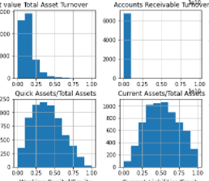
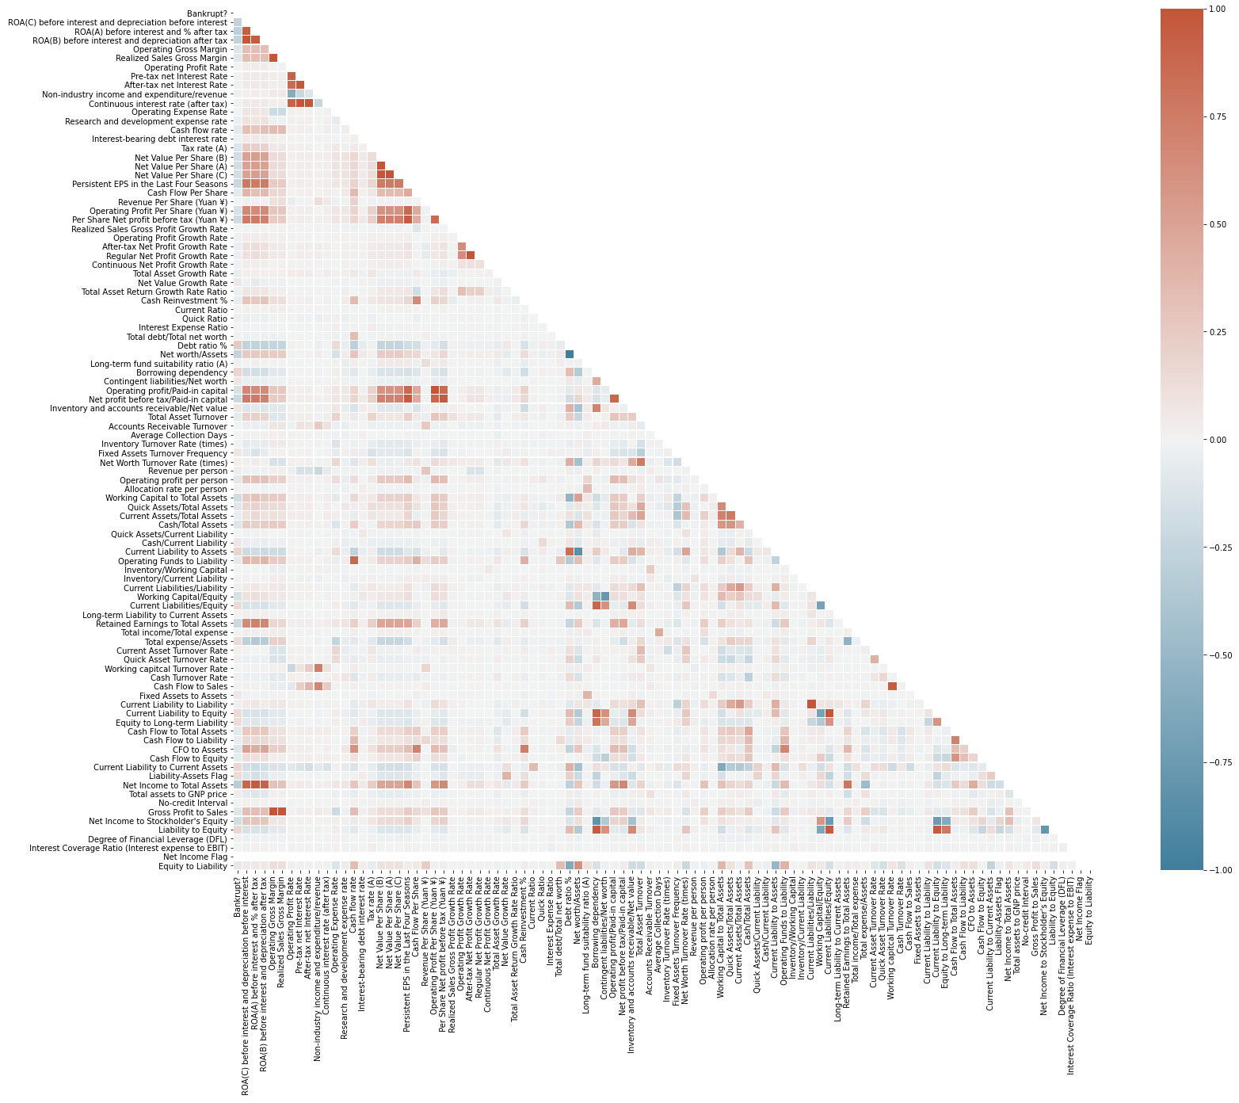
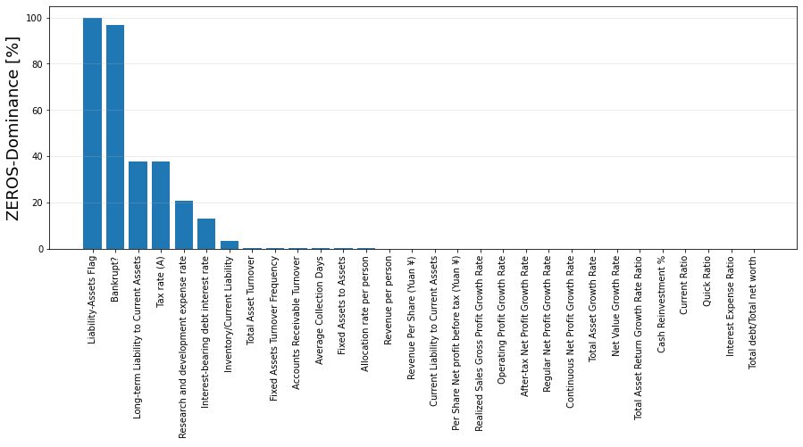
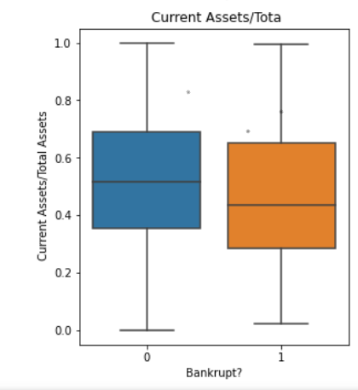
Pre-processing data
Cleaning data (NAN/Null, Zeros, Min/ Max, formats, types)
Basic statistics
Distributions and correlations

Slide 10
Feature selection
95 features
Tree-based estimators (Decision Tree Classifier)
+ RFECV (Recursive feature elimination)
impurity-based feature importance
RFE - Select features by recursively considering smaller and smaller sets of features
RFECV performs RFE in a cross-validation loop to find the optimal number of features.
↓
redundant data and noise
Feature
Selection
↑
Accuracy
21 features
↓
Training time
Notes:
Tree-based estimators can be used to compute impurity-based feature importances
Three benefits of performing feature selection:
- Reduces Overfitting: Less redundant data means less opportunity to make decisions based on noise.
- Improves Accuracy: Less misleading data means modeling accuracy improves.
Reduces Training Time: Less data means that algorithms train faster.
Correlations:
To eliminate features that do not have corrrelation with the bankrupt feature.
To see features that have good correlation and should not be considered together.

Slide 11
Summary
Problem description
Feature selection
Algorithm Implementation
Results

Slide 12
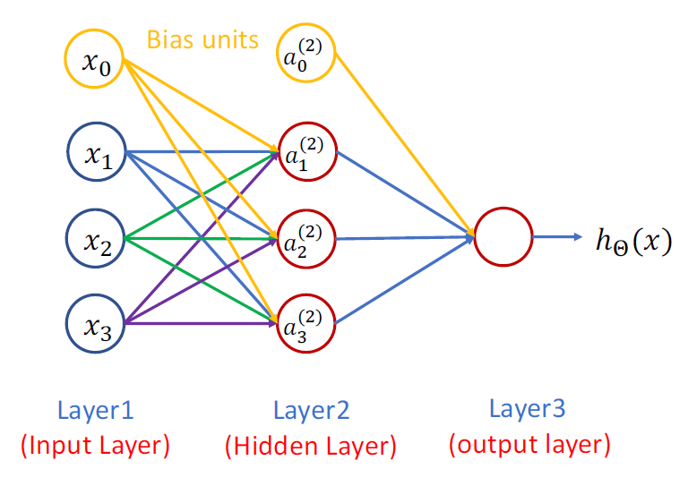
Neural Network
Multi-Layer Perceptron Classifier (MLP)
Notes:
Multi-Layer Perceptron Classifier (MLP)
(trains using Backpropagation)

Slide 13
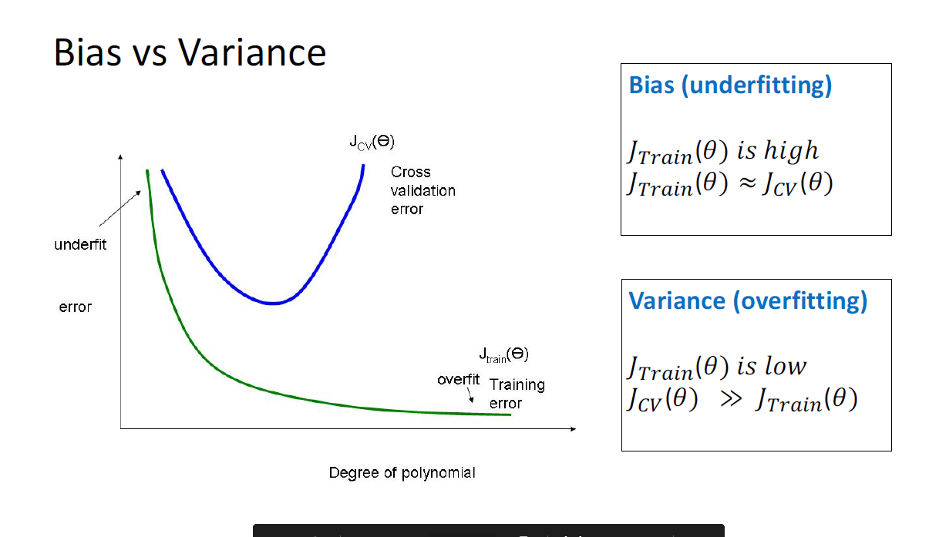
Evaluation of the algorithm
Start: 5, 10, 15 and 21 features
The next scenarios will be defined analyzing the results.
If testing the hypothesis results in a high error rate:
Get more training examples (overfitting) Try smaller sets of features (overfitting) Try getting additional features (underfitting) Try adding polynomial features (underfitting) Try decreasing 𝜆 (underfitting) Try increasing 𝜆 (overfitting)
Neural Networks tend to overfit the data: use regularization
Use model selection to decide the structure of your network (how many hidden layers)

Slide 14
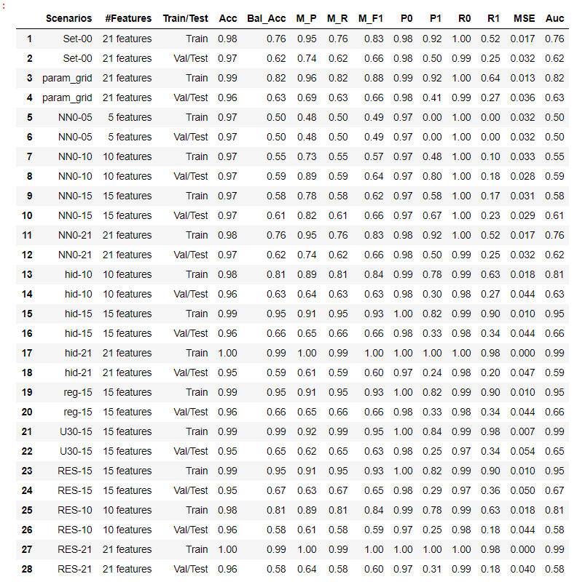
Scenariums:
NN0-5 features >> underfittting
NN0-10 features >> Best Acc, M_P, P1, R0, MSE
NN0-15 features >> Best M_F1
NN0-21 features >> Best Bal_Acc, M_R, P0, R1
Add Hidden Layers
Add regularization term
Results:
The best result until the moment: MLP with 4 Hidden layers and 15 features.
However, these models presents problems with imbalanced data. The model tends to learn the most common class (class 0 - not bankrupt) and it doesn’t abstract information from the other class.

Slide 15
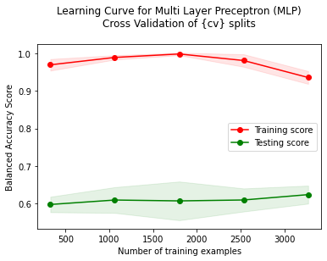
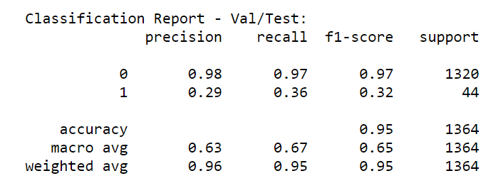
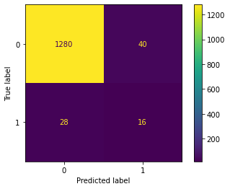
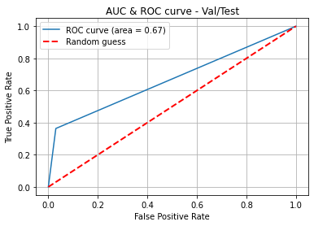
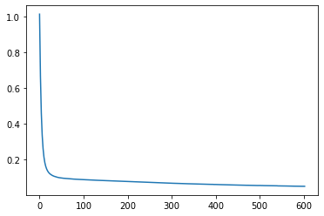
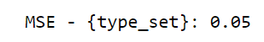
Evaluation of the algorithm
Confusion matrix
Loss Curve
Error
Stratified train-test split
Stratified k-fold cross-validation (max = 5)
Metrics change - from 'accuracy' to 'balanced accuracy, macro f1 score, precision and recall

Slide 16
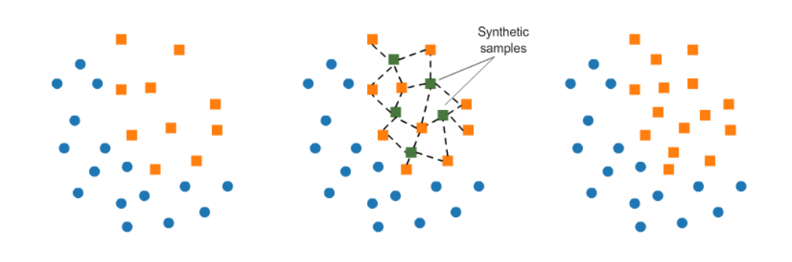
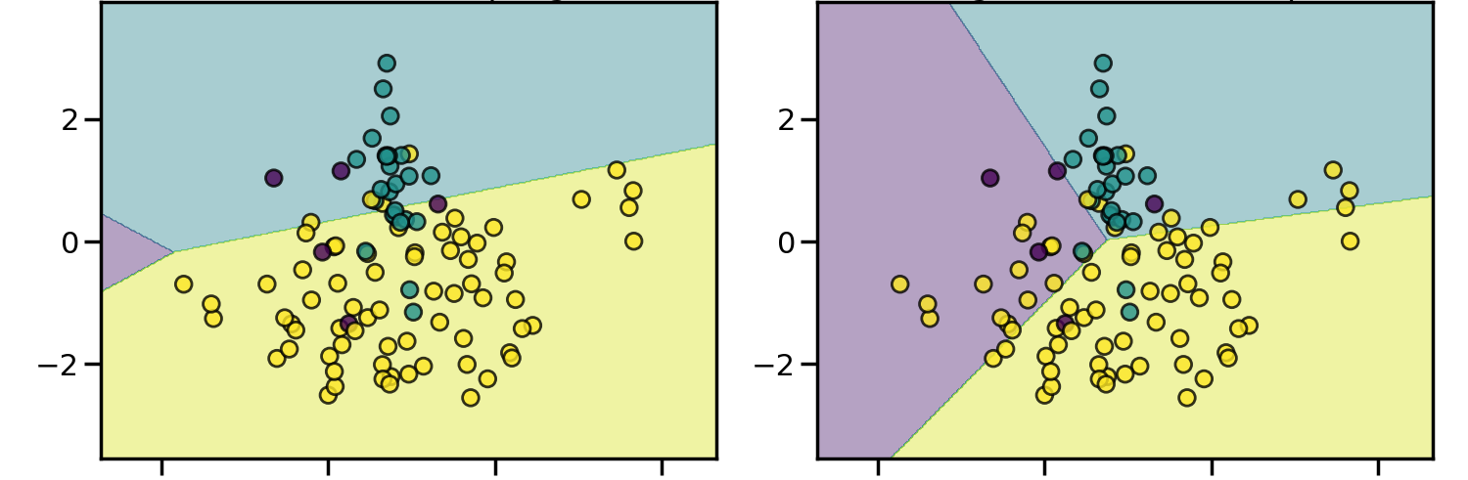
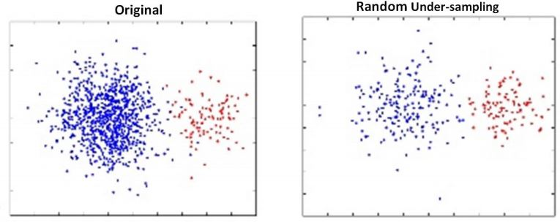
Re sampling techniques for imbalanced data
Random Over Sampler
SMOTE
Oversampling duplicates existing samples randomly, but some times this can lead to overfitting.
Smote uses KNN to create new synthetic samples, but this technique can generate samples that do not represent the reality, mainly if there are many variances in data.
Using under-sampling, removing random records from the majority class, which can cause loss of information.
Random Under Sampler
Notes:
SMOTE (Synthetic Minority Oversampling Technique): consists of synthesizing elements for the minority class, based on those that already exist.
Specifically, a random example from the minority class is first chosen. Then k of the nearest neighbours for that example are found (typically k=5). A randomly selected neighbour is chosen and a synthetic example is created at a randomly selected point between the two examples in feature space.

Slide 17
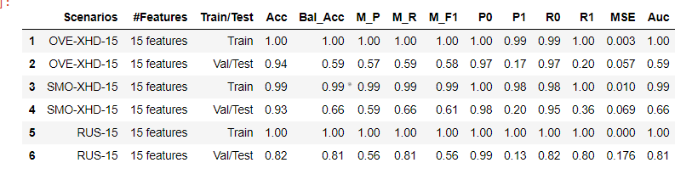
Evaluation of Neural Network (2/2)
Results:
In this case, these techniques overfit the model, increasing generalization error.
Using under sampling, data from class 1 were better classified (only in validation set), however, many class 0 were classified as one (low precision).
These results can happen if there are many variations within the minority class and many similarities between the two classes.
We can try to observe this behaviour testing alternatives as One class SVM and DBSCan.
Notes:
We notice that even using these strategies of oversampling, smote and under sampling, the results are a little worse than without oversampling. Seeking a balanced distribution for a severely imbalanced dataset can lead algorithms to overfit the minority class, increasing generalization error. The effect can be better performance on the training dataset, but worse performance on the holdout or test dataset.
Despite the advantage of balancing classes, these techniques also have their weaknesses.
- The implementation of over-sampling duplicates random records from the minority class, which can cause overfitting.
- Smote use kNN to creates new synthetic samples, however they can be different of the real data. This technique can generate wrong results in cases that the variation within the minority class is very high.
- In under-sampling, the technique involves removing random records from the majority class, which can cause loss of information.
These results can happen if there are many variations within the minority class and many similarities between the two classes.
We can try to observe this testing alternatives as One class SVM and DBSCan.

Slide 18
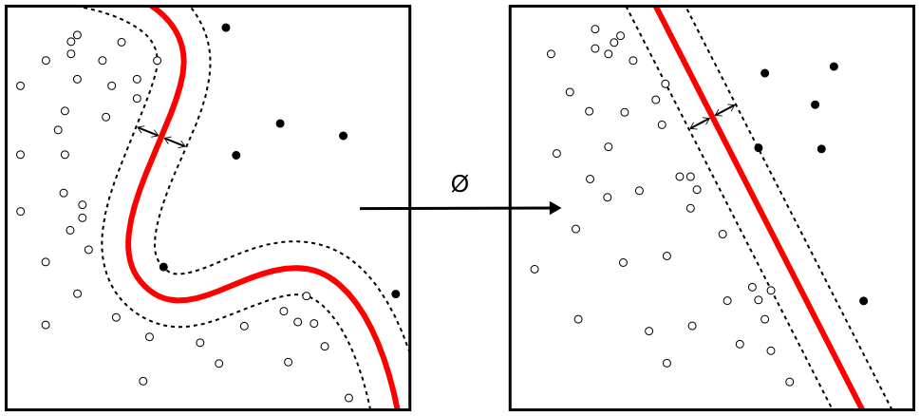
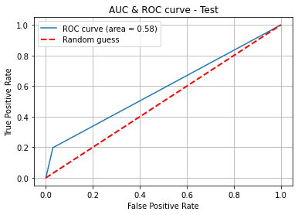

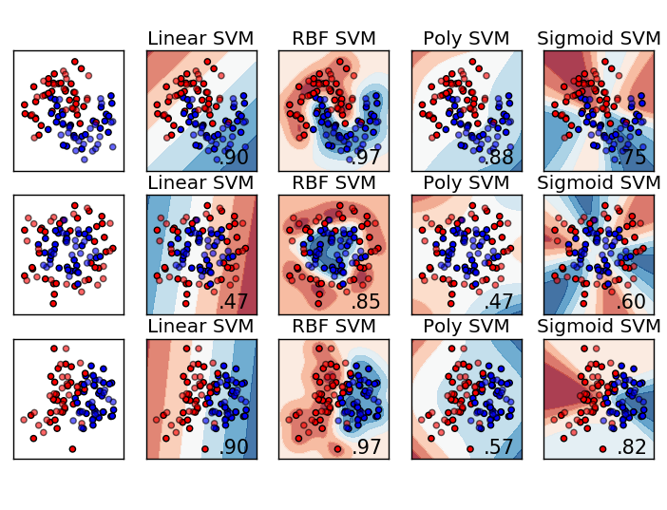
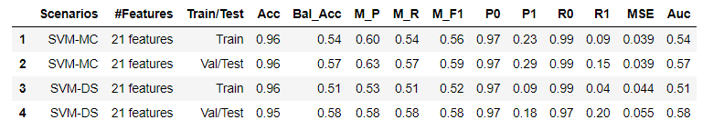
One class SVM
Unsupervised technique
GridSearchCV: scoring = ‘customized’ f1 score macro
kernel: 'rbf’
gamma: 'scale', 'auto', 1e-2, 1e-1, 0.5, 1, 5, 10
nu: 0.01, 0.032, 0.1, 0.2, 0.5
Standardization
Results:
The model was not able to distinguish the data structure between the classes.
In some scenarios, slightly better results were obtained for class 1, however, worse results for class 0 and macro F1.
Trade off : Recall x Precision
Notes:
One-class classification is a field of machine learning that provides techniques for outlier and anomaly detection.
Although not designed for these types of problems, one-class classification algorithms can be effective for imbalanced classification datasets where there are none or very few examples of the minority class, or datasets where there is no coherent structure to separate the classes that could be learned by a supervised algorithm.
It requires the choice of a kernel and a scalar parameter to define a frontier. The RBF kernel is usually chosen although there exists no exact formula or algorithm to set its bandwidth parameter. This is the default in the scikit-learn implementation. The nu parameter, also known as the margin of the One-Class SVM, corresponds to the probability of finding a new, but regular, observation outside the frontier (scikitlearn).

Slide 19
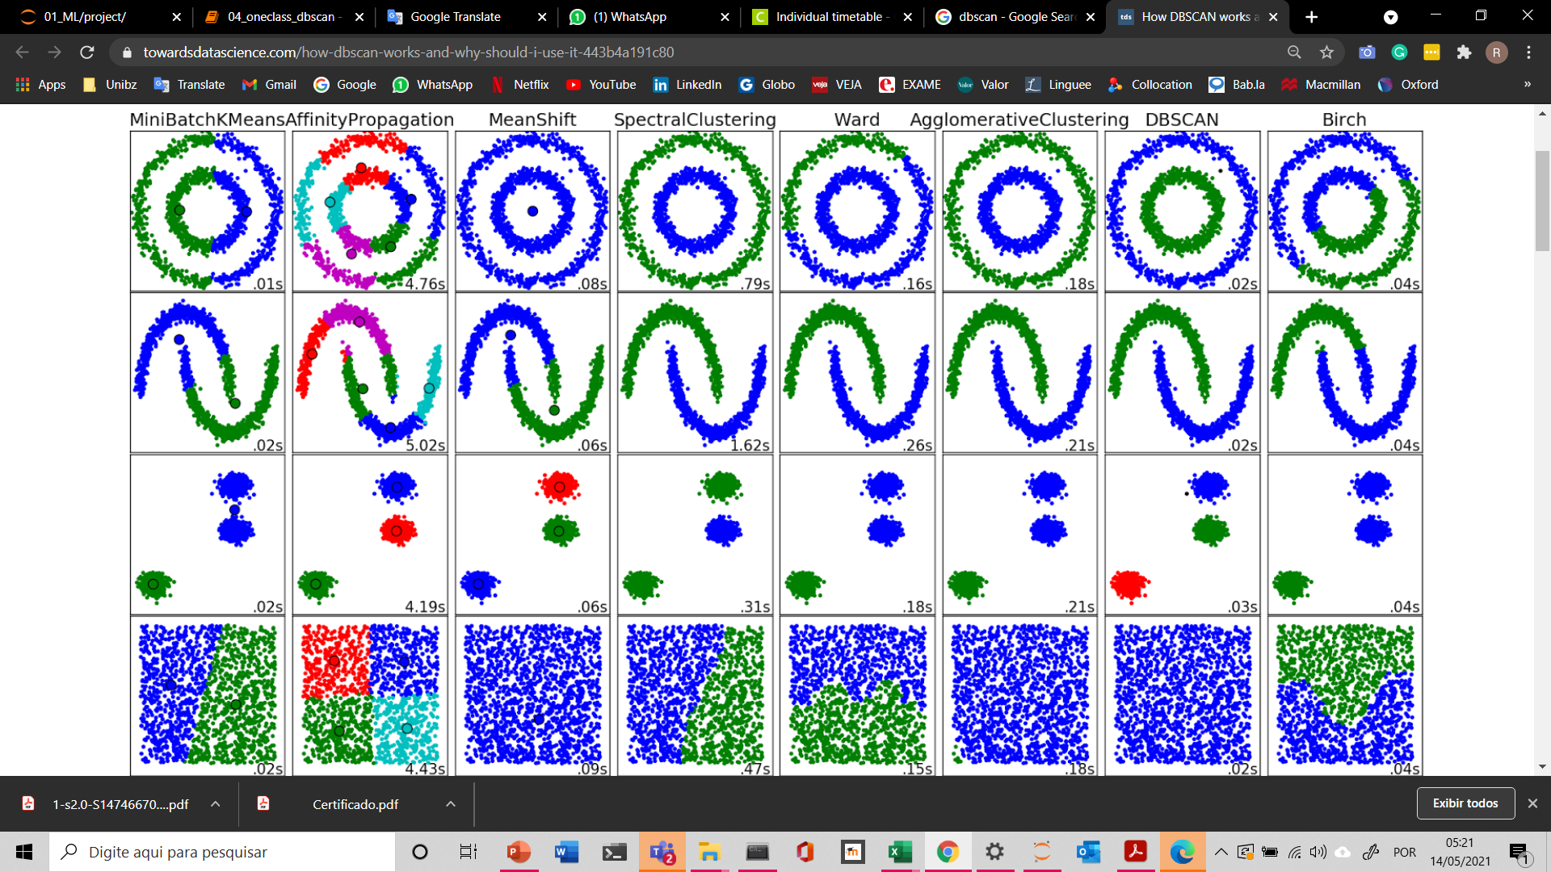
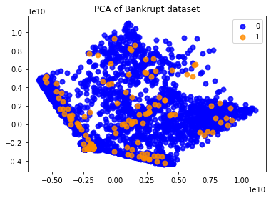
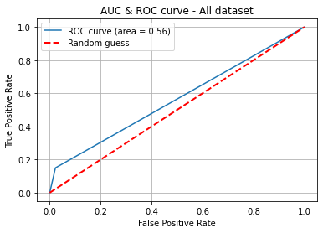

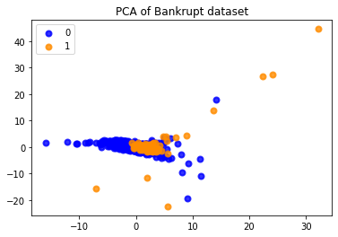
DBScan
Unsupervised technique
GridSearchCV: scoring = f1 score macro
eps: 1 -15 (best = 3)
min_samples: 5 - 15 (best = 8)
Standardization
Results:
We could not identify our class 1 using DBScan. Probably they are not so sparse to be considered ‘noisy samples ’.
After Standardization

Slide 20
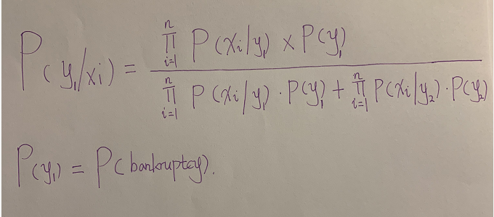
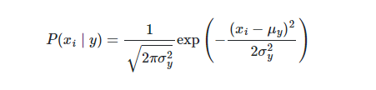
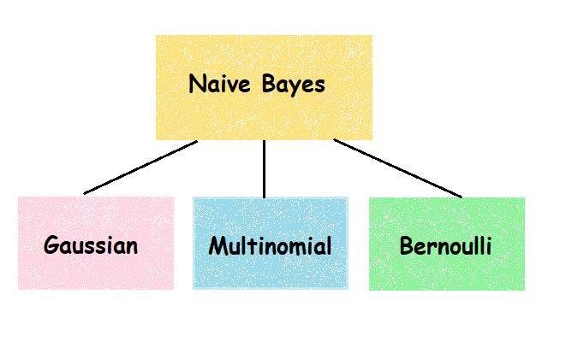
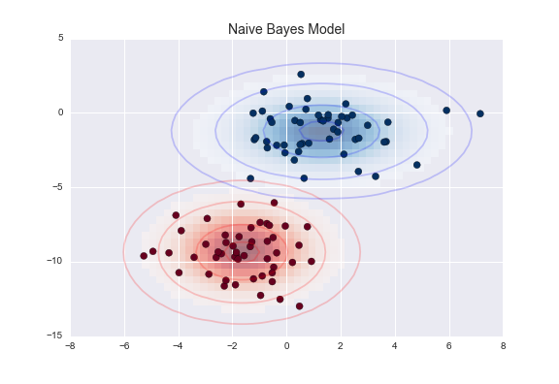
Naive Bayes

Slide 21
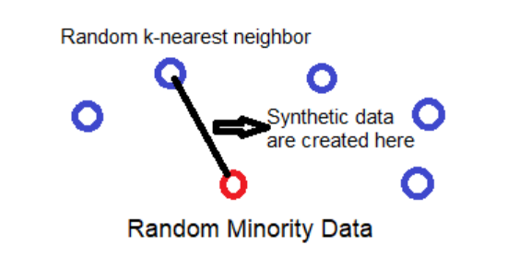
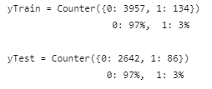
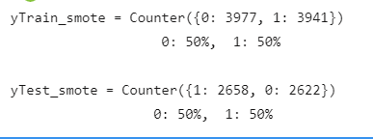
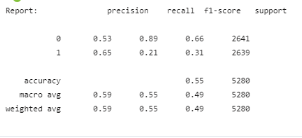
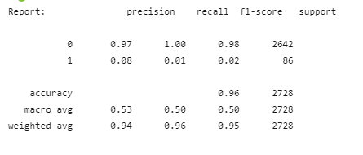
Naive Bayes
Data imbalanced
Data balanced
Results:
After the data is balanced, the results, such as the precision and recall for class 1 and for macro model improved, but are not good. Also the results for class 0 was worse. The f1 score was a little worse either.
The result were not good because Naïve Bayes just roughly calculate, and the formula does not fit good in our data.
This model assumes that the features are independent and the data is normal distributed, which is not true.

Slide 22
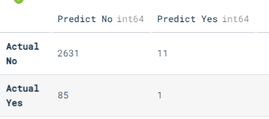
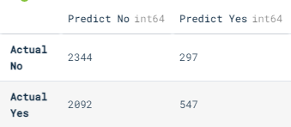
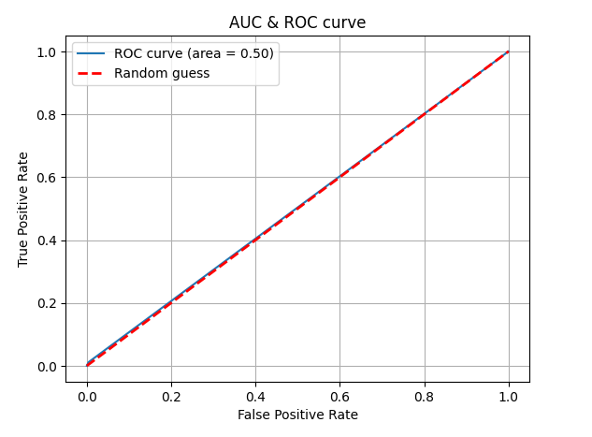
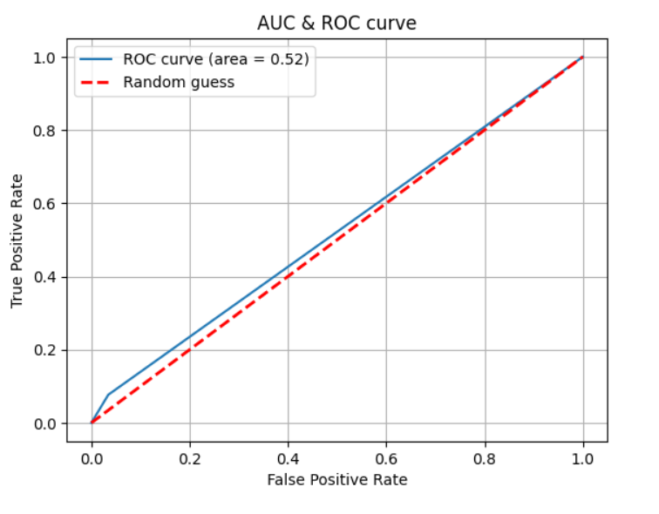
Naive Bayes
Data imbalanced
Data balanced
Results:
Naïve bayes is not suitable for our case, the accuracy is somewhat improved with the data balanced, but the result is still not good.

Slide 23
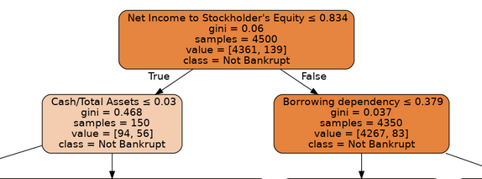
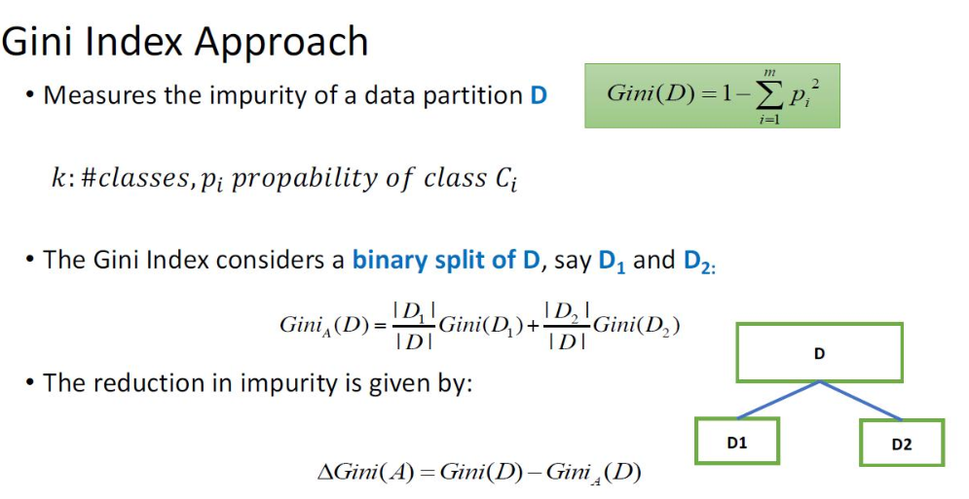
Decision Tree
A kind of Supervised machine learning algorithm which works by learning a hierarchy set of if-then-else decision rules using ENTROPY, GINI index and Gain Ratio
Notes:
Measures the impurity of a partition then performs splitting…
Gini:- Gini impurity measures the degree or probability of a particular variable being wrongly classified when it is randomly chosen. But what is ‘impurity’? If all the elements belong to a single class, then it can be called pure. The degree of Gini index varies between 0 and 1, where 0 denotes that all elements belong to a certain class or if there exists only one class, and 1 denotes that the elements are randomly distributed across various classes.
A Gini Index of 0.5 denotes equally distributed elements into some classes. Ie in SMOTE technique
While building the CART decision tree, we would prefer choosing the attribute/feature with the least Gini index as the root node…..
Entropy

Slide 24
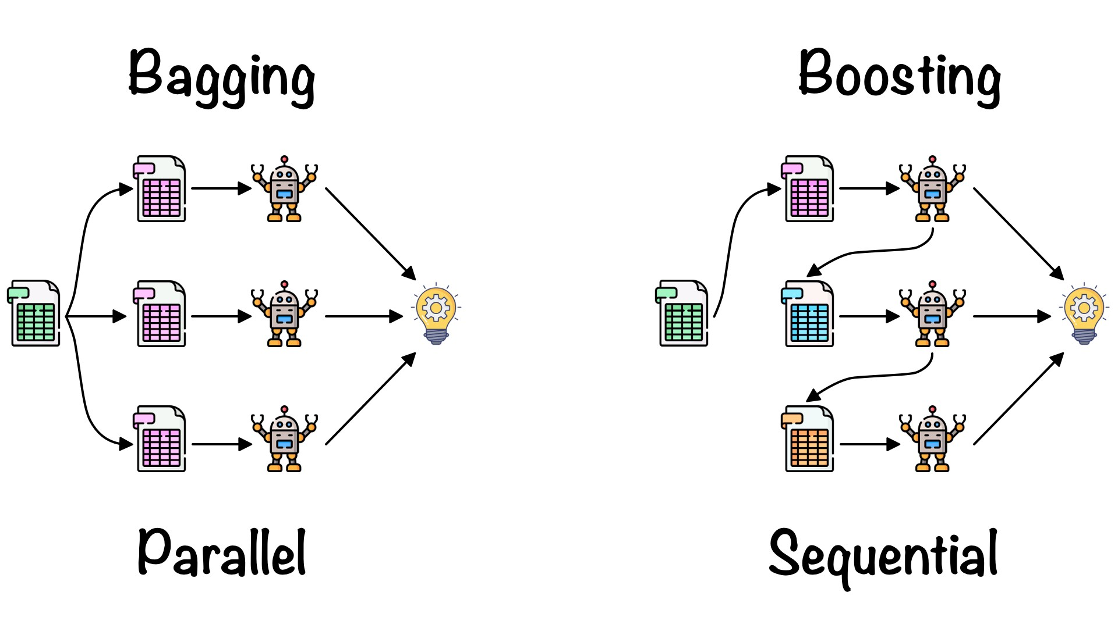
STRATEGIES TO HANDLE IMBALANCE
The use of ensemble methods.
Averaging methods eg:- Bagging methods, Forests of randomized trees, etc
Boosting methods eg:- AdaBoost, Gradient Tree Boosting etc
Also anomalies can be dealt with using Parameterised strategies like
SMOTE
Under & Over sampling,
Class balancers(WEKA)
Class & Sample weighting
Notes:
Since we are dealing with an imbalanced dataset, there are strategies in supervised learning algorithms as I have mention earlier that perform well. However, the Decision tree seems is not promising on such a kind of dataset for that matter we explore parametrized strategies like SMOTE among others.
In averaging methods, the driving principle is to build several models independently and then to average their predictions. On average, the combined estimate is usually better than any of the single base estimator because its variance is reduced. Eg like the professor’s example of checking with different doctors
In boosting methods, base estimators are built sequentially, and one tries to reduce the bias of the combined estimator. The motivation is to combine several weak models to produce a powerful ensemble. Eg like the professor’s example of checking with different doctors with the most experience ie assign different weights to the models; choose the highest weight
SMOTE:
SMOTE (Synthetic Minority Oversampling Technique) works by randomly picking a point from the minority class and computing the k-nearest neighbors for this point. The synthetic points are added between the chosen point and its neighbors.

Slide 25
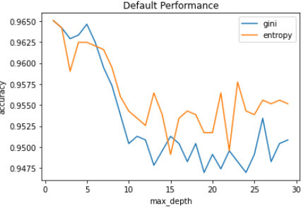
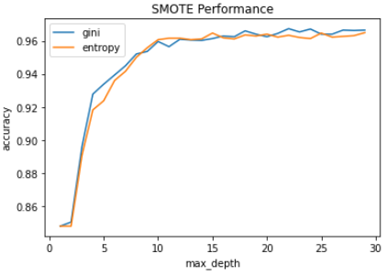
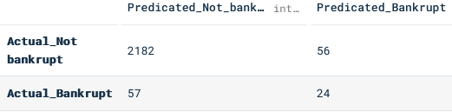



Evaluation of the algorithm
Notes:
The Metric Trap: One of the major issues that new developer users fall into when dealing with unbalanced datasets relates to the metrics used to evaluate their model. Using simpler metrics like accuracy score can be misleading. In a dataset with highly unbalanced classes, the classifier will always “predicts” the most common class without performing any analysis of the features and it will have a high accuracy rate, obviously not the correct one.
What happens if the model doesn’t do well? Check for underfitting or overfittling by computing the cost on training, validation and test. Then try to increase the accuracy with other models….

Slide 26


Evaluation cont’d
Default Tree
The results reported by the ROC AUC showed different with each configuration of k-neighbors parameter.
k=5, Mean ROC AUC: 0.65
SMOTE’d Tree
The results reported by the ROC AUC showed different with each configuration of k-neighbors parameter.
k=5, Mean ROC AUC: 0.97
Notes:
The Receiver Operating Characteristic (ROC) curve is a standard technique for summarizing classifier performance over a range of tradeoffs between true positive and false positive error rates (Swets, 1988). The Area Under the Curve (AUC) is an accepted traditional performance metric for a ROC curve.

Slide 27

Results from Decision Trees
The Default tree
Maximum tree depth: 15
Number of leaves: 107
The SMOTE’d tree
Maximum tree depth: 32
Number of leaves: 268
The model demonstrated a clear decision boundary of class separation on how it evolved and reacted when fitted with the balanced and imbalanced dataset.

Slide 28

Extra Analysis - Imbalanced data
Techniques:
Standard models
Class weight
Re-sampling
- oversampling
Techniques of bagging and boosting
Balanced random forest
Balanced bag of histogram gradient boosting
1
2
Random forests: ensemble learning method, constructing a multitude of decision trees at training time and outputting the class that is the mode of the classes.
Balanced random forest: randomly under-samples each bootstrap sample to balance it.
Histogram-based Gradient Boosting Classification Tree: similar to gradient boosting trees, reduces the number of splitting points to consider, faster than Gradient Boosting Classifier
BalancedBaggingClassifier: Bagging, it includes an additional step to balance the training set at fit time using a given sampler.
3
4
Notes:
https://scikit-learn.org/stable/modules/ensemble.html#histogram-based-gradient-boosting

Slide 29




Extra Analysis - Imbalanced data
LR
RF
BBC
Results:
Apparently, 3 good solutions. However, bad results for precision 1!

Slide 30
Results: Comparison of algorithms on imbalanced data
 | Decision Tree | Neural Network | Naive Bayes | DT SMOTE | NN resampl. | NB SMOTE | Log. Reg. SW | Bal. Rand. Forest | Bal. Bag Hist. Grad. Boost. | One Class SVM | DBScan
Accuracy | 0.94 | 0.95 | 0.96 | 0.93 | 0.93 | 0.50 | 0.86 | 0.86 | 0.90 | 0.95 | 0.95
Bal. Acc. | 0.64 | 0.67 | 0.49 | 0.95 | 0.66 | 0.51 | 0.85 | 0.89 | 0.86 | 0.58 | 0.56
Macro Precis. | 0.62 | 0.63 | 0.50 | 0.95 | 0.59 | 0.66 | 0.58 | 0.59 | 0.60 | 0.58 | 0.58
Macro Recall | 0.52 | 0.67 | 0.49 | 0.95 | 0.66 | 0.50 | 0.85 | 0.89 | 0.86 | 0.58 | 0.56
Macro F1 | 0.62 | 0.65 | 0.06 | 0.95 | 0.61 | 0.35 | 0.60 | 0.61 | 0.64 | 0.58 | 0.57
ROC AUC | 0.62 | 0.67 | 0.50 | 0.95 | 0.66 | 0.52 | 0.85 | 0.89 | 0.86 | 0.58 | 0.56
P0 | 0.97 | 0.98 | 0.97 | 0.97 | 0.98 | 0.50 | 0.99 | 1.00 | 0.99 | 0.97 | 0.97
P1 | 0.27 | 0.29 | 0.03 | 0.94 | 0.20 | 0.83 | 0.17 | 0.17 | 0.21 | 0.18 | 0.18
R0 | 0.97 | 0.97 | 0.03 | 0.94 | 0.95 | 1 | 0.86 | 0.85 | 0.90 | 0.97 | 0.98
R1 | 0.27 | 0.36 | 0.96 | 0.97 | 0.36 | 0.01 | 0.83 | 0.92 | 0.82 | 0.20 | 0.15
This results only occurs if we smote all dataset (Fake – ‘optimistic evaluation of the model’). If we smote only the train, we get bad results.
Copies of the same point may end up in both the training and test sets. This allows the classifier to cheat, because when trying to make predictions on the test set the classifier will already have seen identical points in the train set. The whole point of having a test set and a train set is that the test set should be independent of the train set.

Slide 31
Lessons learned and Conclusions
Significance of the models/ techniques
Performance
Strengths
Limitations
Notes:
Limitations

Slide 32
Lessons learned and Conclusions
Significance of the models/ techniques
Performance
Strengths
Limitations
`Decision tree was the model with the better results. It allows an easy understanding of the criteria to classify bankrupt companies.
The standard NNs does not support some alternatives for imbalanced classification, such as class weight and sample weight. It is necessary to customize.
We could not identify the minority class using OneClassSVM or DBScan, probably because the data has many similarities between the two classes and are not so sparse.
Naive Bayes performs badly because it just roughly calculate, and the formula does not fit good in our data. This model assumes that the features are independent and the data is normal distributed.
The tree rearranged, changing the root, leaves and structure when used sample weight or resample techniques.
Resample techniques can be useful, however, sometimes they do not have good results. It is important to understand the concept of each technique and how to apply them.
Other techniques as bagging and boosting can be very useful for imbalanced data.
We learned a lot with this dataset and are more able to recommend which classifier is best suited for a particular problem.
In a real-world scenario, a largest recall can be useful to correctly identify as much as bankrupt company as possible. On the other hand, this reflect in a low precision and large number of false positive.

Slide 33
Lessons learned and Conclusions
Significance of the models/ techniques
Performance
Strengths
Limitations
The performance of some models become a little slow when they iterate over some parameters. We preferred to keep these iterations to analyse in more detail the behaviour and observe the results.
There are many other techniques to explore that can improve results of imbalanced data. Eg, better NNs modes, optics, adaboost, etc.
Also, there are a range of alternatives of resample techniques to be explored.
We can improve our results of DT models applying techniques like pruning. Theres an aspect of classifier cheating
In the project several models, techniques and variables were tested and considered to find a good solution.
Supervised: NNs, NBs, DTs, *Logistic Regression, *Random Forest
Unsupervised: *OneClassSVM, *DBSCan
Train/Validation/test, Cross validation, GridSearchCV, pipeline
Resampling techniques
Bagging and boosting
Notes:
With techniques to hand imbalance; copies of the same point may end up in both the training and test sets. This allows the classifier to cheat, because when trying to make predictions on the test set the classifier will already have seen identical points in the train set. i.e The whole point of having a test set and a train set is that the test set should be independent of the train set

Slide 34
THANK YOU FOR YOUR ATTENTION!

